Slide 1
Master in Applied &
Computational Mathematics
BNumMet
A Scholar implementation of Numerical Methods in Python enhanced with interactive widgets
Author: Fernando Bellido Pazos
Tutor: Juan Manuel Perez Pardo
Pages 1-2
End of Master’s Thesis: Defense

Slide 2
Contents
Introduction
State of the art
Previous Work
Objectives
Software Development
Software Description
Linear Systems
Interpolation
Non-Linear Equation Solver
Least Squares
Random Number Generator
Ending Remarks

Slide 3
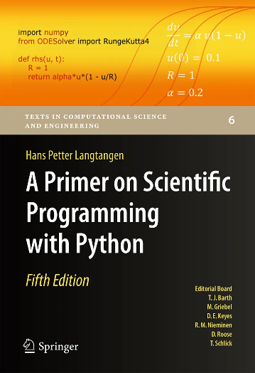
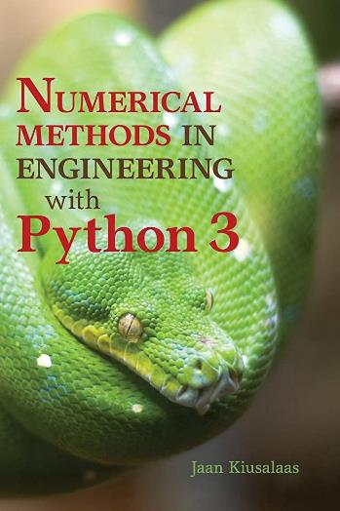
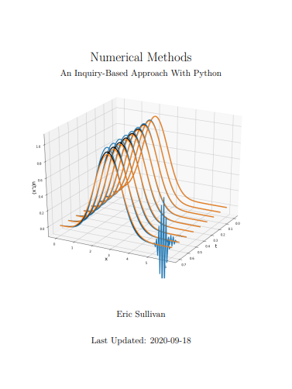
State of the Art
Notes:
Teach computer programming using examples from Mathematics & Natural Sciences
Teach numerical methods by understanding the pros & cons of each method rather than how to implement it
Focuses on how to implement the numerical method not on how the rigorously works

Slide 4
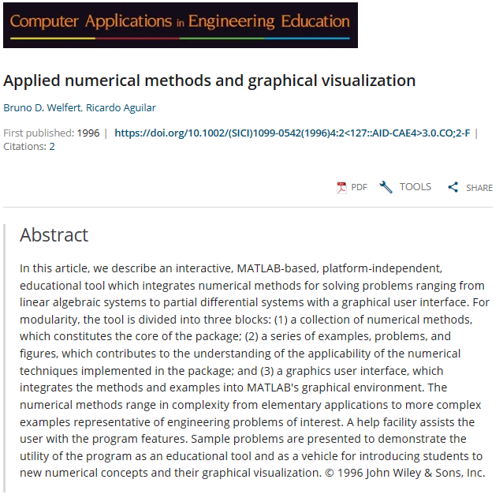
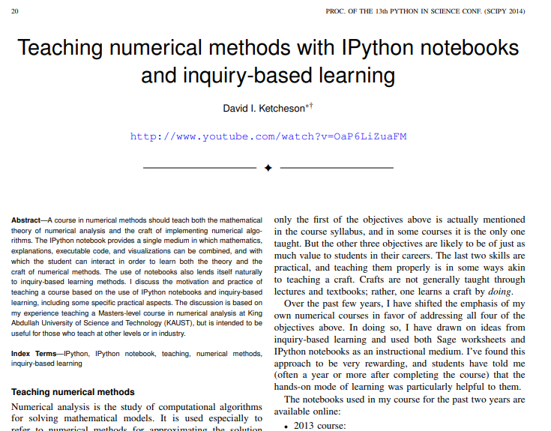
State of the Art
Notes:
Show the potential on Jupyter’s notebook to enhance teaching numerics by doing graphs and exercises, it does not show the numerical methods
Provides implemented methods and a GUI, it is a visual solver allowing inputs and providing the solution

Slide 5

Previous Work
Numerical Computing With MATLAB – Cleve B.Moler
Programming Language: MATLAB
11 Chapters : Code & Visualization
Private Licensed
Graphical User Interface: Not Intuitive and user-friendly
MATLAB’s Home License: 119€
Pages 3-4

Slide 6
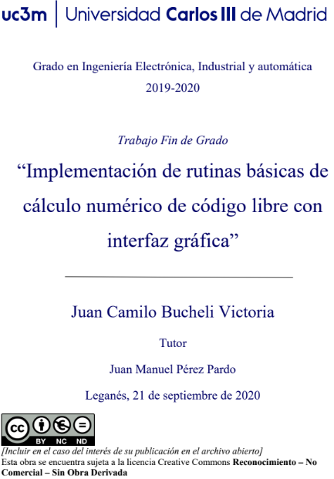
Previous Work
End of Degree’s Thesis – Juan Camilo Bucheli
Programming Language: Python
2 Packages: Linear Systems & Interpolation
Open Source Licensed (Apache 2.0)
Graphical User Interface: NOT functional to this day
Language: Spanish
Pages 4-6

Slide 7
Objectives
Scholar Numerical Method
Graphical User Interface
BNumMet
Students

Slide 8
Objectives
General Code
Open Source
English
G.U.I.
Provide Insight on algorithm
Modular on Input
PC-Human Interaction theory
Efficiency
Self-Contained
Easy to use
Interact and observe changes Dynamically
Easy to Read
Functional
Pages 7-8

Slide 9
Software Development
Initiation
Roles
Life Cycle Model: Iterative Life Cycle
Planning
Schedule Frame: October 2022 - 15 June 2023 in 2 Week Iterations
Execution
Quality Assurance: Unit Test & SonarQube
Software Configuration Management: Github & vX.Y.Z Scheme
Ending
Packaging: PIP & Public Github
Development Framework: Python $≥3.8$ & Jupyter
Development Framework: Python ≥3.8 & Jupyter
Licensing: GNU Affero General Public Licence v3.0
Pages 10-16
Notes:
PyPi: Python Package Index

Slide 10
Software Description

Slide 11
Linear Systems
BNumMet
Interpolation
Non-Linear Equation Solvers
Least Squares
Random Number Generators
Written from scratch
Original Implementations
MathWorks Benchmarking
Analysis of Solutions provided

Slide 12
Linear Systems
Packages
LU Decomposition*
Forward & Backward Substitution
LU Solver
QR Decomposition
QR Solver
Pages 17,22-25
Notes:
LU Decomposition: P*A=L*U
L = Lower Triag
U = Upper Triag
Forward & BackWard Substitution: Uses the form of Lower & Upper triangular to substitute
LU Solver: Combination of previous methods to preserve the “Self-contained” objective
QR Decomposition: Q*R=A
Q = Orthogonal Matrix
R = Upper Triag
Using householder
QR Solver: Does not calculate Q

Slide 13
Linear Systems
Discussion: LU Decomposition
X
A
B
C
B
X
A
C
– 1/X ·
C
Pages 18-21
Notes:
[C] & [X|A] ~ Interpreted as Vectors by Python but we need Matrices → How can we make them matrices

Slide 14
Linear Systems
Discussion: LU Decomposition
[C|B] – 1/X·[C] [X|A]
X
A
B
B
C
X
A
C
– 1/X ·
C
Page 18
Notes:
[C] & [X|A] ~ Interpreted as Vectors by Python but we need Matrices → How can we make them matrices

Slide 15
Linear Systems
Discussion: LU Decomposition
Submatrices Syntax
New-Axis Syntax
Outer Product
For Loop
A[col + 1 :, :][:, [col]] @ A[[col], :][:, col + 1 :]
A[col + 1 :, col][:, np.newaxis]
@ A[col, col + 1 :][np.newaxis, :]
np.outer(A[col + 1 :, col], A[col, col + 1 :])
for col in range(n):
<Pivoting>
for row in range(col + 1, n):
A[row, col + 1 :] - A[row, col] * A[col, col + 1 :]
B
C
X
A
C
– 1/X ·
Pages 18-21

Slide 16
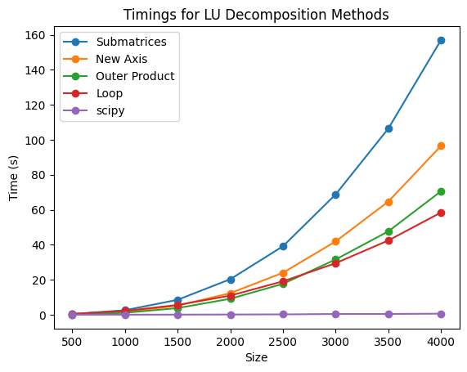
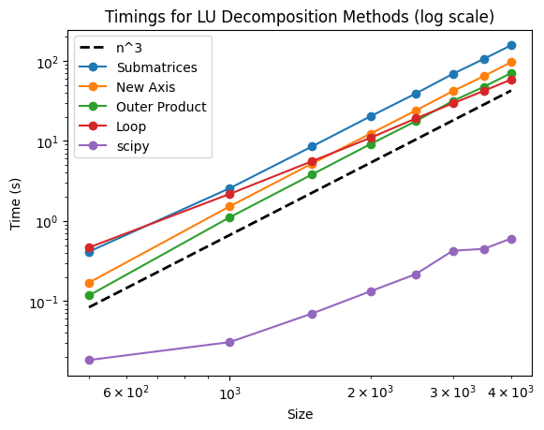
Linear Systems
Discussion: LU Decomposition
 | Slope
■ Submatrices | 2.8852
■ New Axis | 3.0434
■ Outer Product | 3.0717
■ Loop | 2.334
■ Scipy | 1.8136
Pages 18-21
Notes:
Figure 1:
Submatrices the worst
For Loop improves to be the best at the long term
Scipy uses LAPACKS
Figure 2:
We observe the slope of $\frac{2}{3}n^{3}$
For loop does not achieve it since we haven’t gotten to the point where $n^{3}$ starts counting
Figure 3: Linear Regression
Better submatrices syntax vs NewAxis
For-Loop: Final Choice – Fast and Naive

Slide 17
Interpolation
Packages
Polynomial Interpolation
Piecewise Linear Interpolation
Piecewise Cubic Interpolation
Piecewise Cubic Hermite Interpolation
Pages 25-30
Notes:
PolyInterpol: Using Lagrange Interpolation Formula
Piecewise Linear Interpolation:
Cubic Piecewise:
Approximation using the second derivative – Interior
‘Not a Knot’ – Exterior
PCHIP:
Harmonic mean – Interior
Non-Center, Shape-Preserving & 3-point formula – Exterior

Slide 18
Interpolation
Discussion: Interpolation
Y
(3,4)
(5,4)
Slope C
Slope D
Slope B
(4,3)
(2,1)
Slope A
X
(1,?)
(7/3,?)
(8/3,?)
(3.5,?)
(4.5,?)
K=[
1
2
2
3
4
]
Pages 31-33
Notes:
Read Data Points
Calculate the slopes
Read meshpoints
Divide it into sections & tag the meshpoints
# This is useful when the mesh is unordered
Evaluate according to the sections

Slide 19
Interpolation
Discussion: Interpolation
K=[
1
(1,?)
Evaluate using slope A
2
(7/3,?)
Evaluate using slope B
2
(8/3,?)
3
(3.5,?)
Evaluate using slope C
4
(4.5,?)
Evaluate using slope C
]
Pages 31-33
Notes:
Evaluate according to the sections

Slide 20
Interpolation
Discussion: Interpolation
List Comprehension
v = [ y[k[i] - 1] + s[i] * (d[k[i] - 1] + s[i] * (c[k[i] - 1] + s[i] * b[k[i] - 1]))
for i in range(len(u)) ]
Evaluate the mesh points
Fancy Indexing
v = y[k] + s * (d[k] + s * (c[k] + s * b[k]))
Pages 31-33
Notes:
List Comprehension: Analogous to defining a set by compression
Fancy Indexing: Numpy’s implementation of vectors notation, similar to Matlab’s

Slide 21
Interpolation
Discussion: Interpolation
List Comprehension
v = [ y[k[i] - 1] + s[i] * (d[k[i] - 1] + s[i] * (c[k[i] - 1] + s[i] * b[k[i] - 1]))
for i in range(len(u)) ]
Evaluate the mesh points
Fancy Indexing
v = y[k] + s * (d[k] + s * (c[k] + s * b[k]))
Pages 31-33
Notes:
List Comprehension: Analogous to defining a set by compression
Fancy Indexing: Numpy’s implementation of vectors notation, similar to Matlab’s

Slide 22
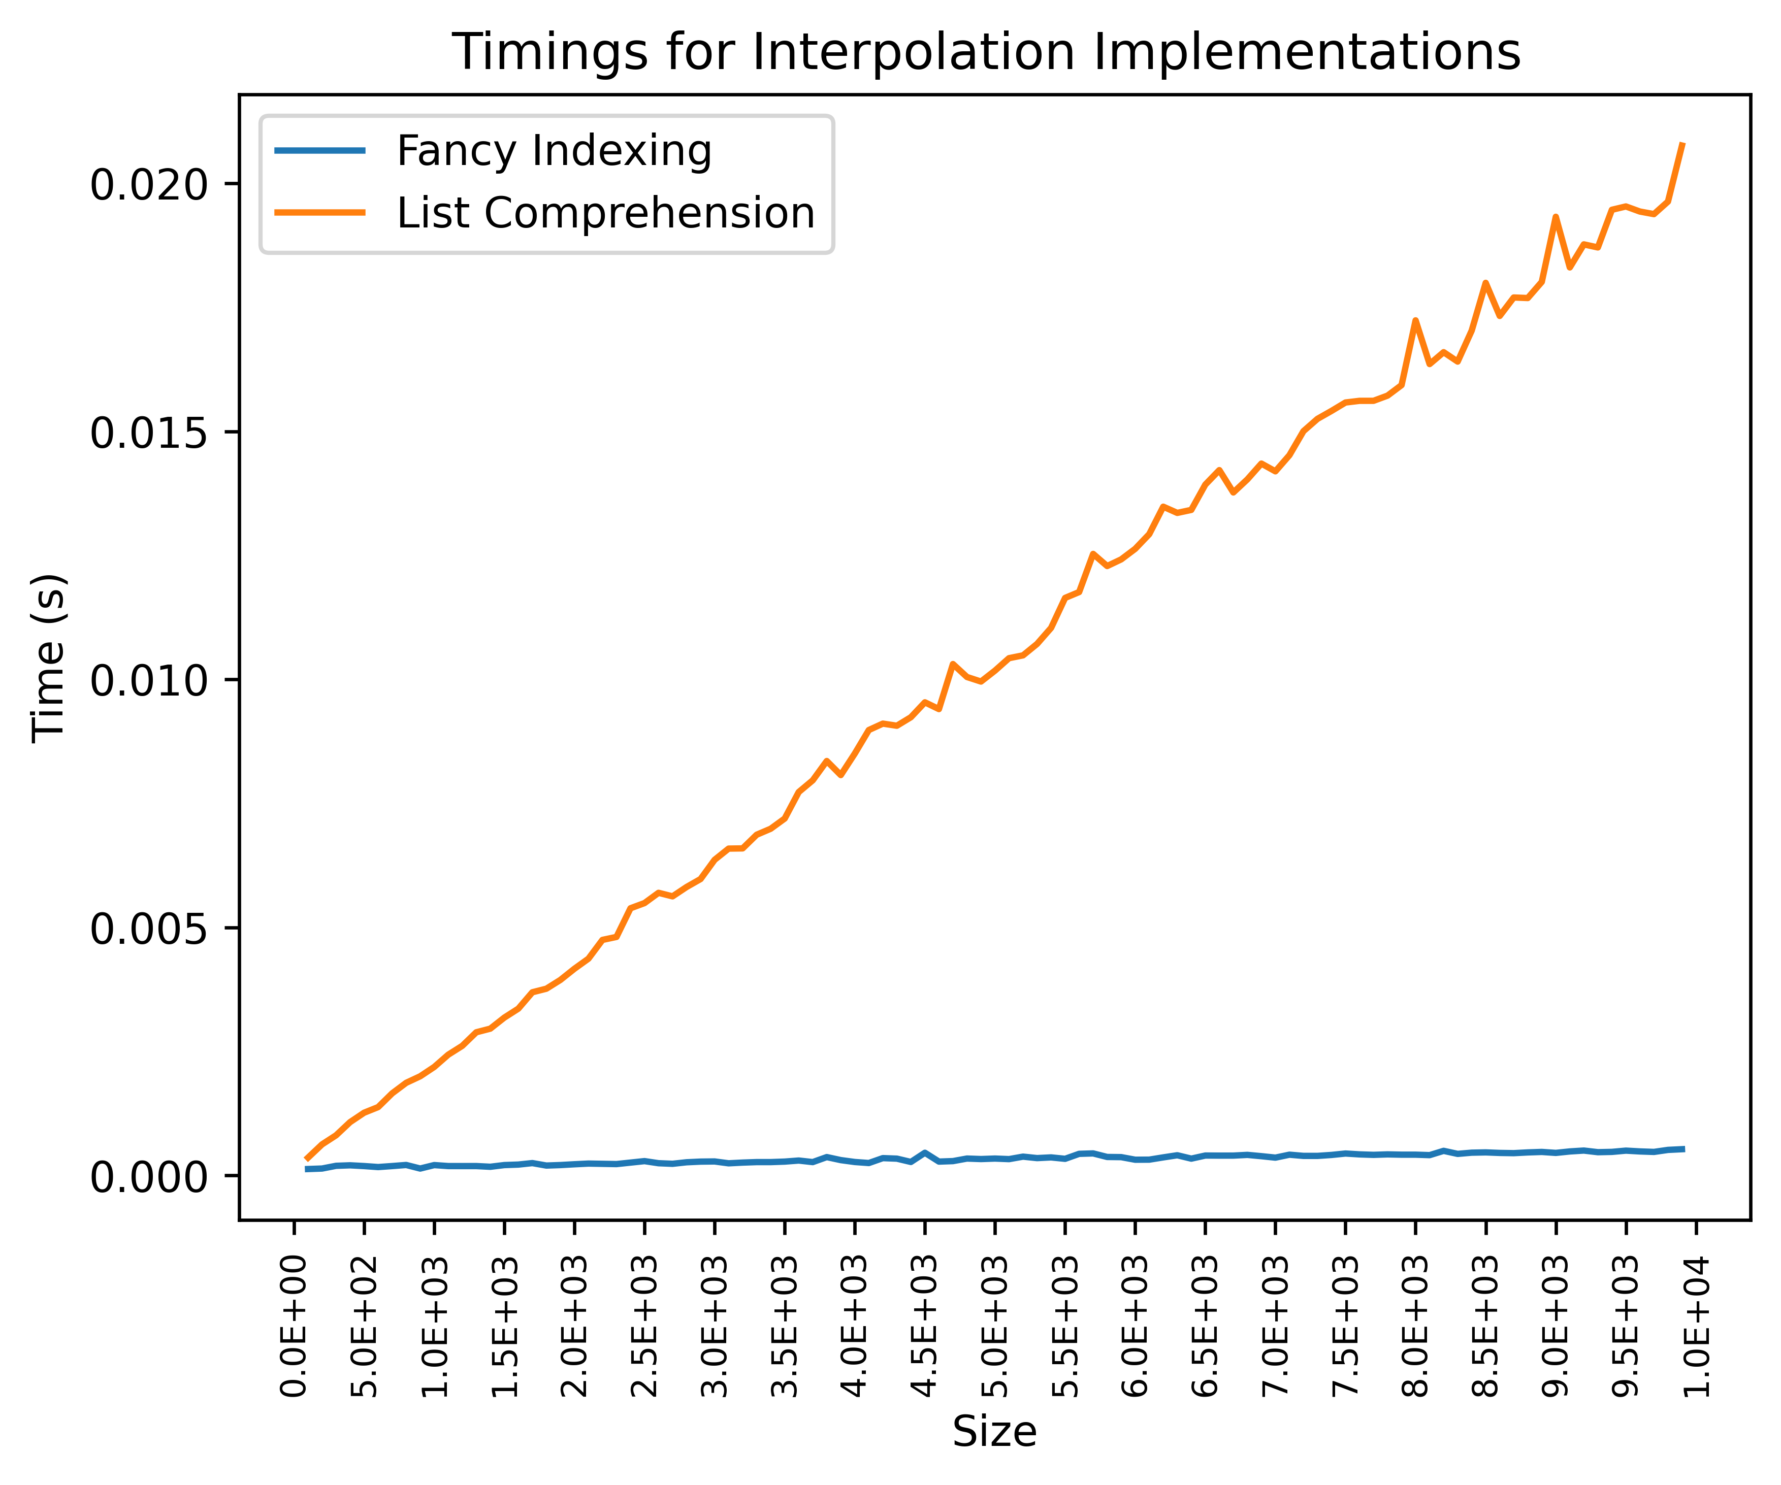
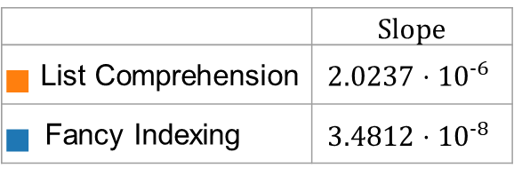
Interpolation
Discussion: Interpolation
 | Slope
■ List Comprehension | $$2.0237⋅{10}^{−6}$$
■ Fancy Indexing | $$3.4812⋅{10}^{−8}$$
Pages 31-33

Slide 23
Non-Linear Equation Solver
Packages
Bisection
Newton’s Method
Secant Method
Inverse Quadratic Interpolation
Brent-Dekker’s Method
Pages 34-40

Slide 24
Non-Linear Equation Solver
Discussion
Original
Brent-Dekker
MATLAB’s
Brent-Dekker
Scipy’s Brent-Dekker
Vs.
Vs.
Pages 41-48

Slide 27
Random Number Generators
Packages
Lehmer’s
Linear Congruential Algorithm
$$x_{n+1}=\left(a⋅x_{n}+c\right) mod\left(n\right)$$
𝑥_(𝑛+1)=(𝑎⋅𝑥_𝑛+𝑐) 𝑚𝑜𝑑(𝑛)
Marsaglia’s
Subtract With Borrow or Add with Borrow
$$f\left(x_{1},x_{2},…,x_{r},c\right)=\left\{\begin{aligned}\begin{matrix}(x_{2},…,x_{r},x_{r+1−s}−x_{1}−c,0) & x_{r+1−s}−x_{1}−c≥0\end{matrix} \\ \begin{matrix}(x_{2},{…,x_{r},x}_{r+1−s}−x_{2}−c+b,1) & x_{r+1−s}−x_{1}−c<0\end{matrix}\end{aligned}\right.$$
𝑓(𝑥_1,𝑥_2,…,𝑥_𝑟,𝑐)={█(■8((𝑥_2,…,𝑥_𝑟,𝑥_(𝑟+1−𝑠)−𝑥_1−𝑐,0)&𝑥_(𝑟+1−𝑠)−𝑥_1−𝑐≥0)@■8((𝑥_2,〖…,𝑥_𝑟,𝑥〗_(𝑟+1−𝑠)−𝑥_2−𝑐+𝑏,1)&𝑥_(𝑟+1−𝑠)−𝑥_1−𝑐<0))┤
Mersenne-Twister
Up to date RNG
Used in Python & R
Pages 50-56

Slide 28
Ending
Linear Systems
BNumMet
Interpolation
Non-Linear Equation Solvers
Least Squares
Random Number Generators
Pages 60-102

Slide 29
Ending
LIVE DEMO
Pages 60-102

Slide 30
Summary
BNumMet
Scholarly Numerical Methods
Visual Interface
Capture the Essence of the Methods
Introduction to Python, Numerical Methods & Jupyter
Efficient, Original & Competitive
Go-To guide for students
Original didactic tool for undergraduates & teachers
Compared and Analysed
Open-Sourced
“Learning is priceless”

Slide 31
End of Master’s Thesis: Defense
Thank you for your attention
Any questions?
NAME
Fernando Bellido Pazos
MASTER
Applied & Computational Mathematics
TUTOR
Juan Manuel Perez Pardo
Pages 103

Slide 32
Linear Systems
Visualizer BNumMet

Slide 33
Interpolation
Visualizer BNumMet

Slide 34
Non Linear Equation Solver
Visualizer BNumMet

Slide 35
Least Squares
Visualizer BNumMet

Slide 36
Random Number Generators
Visualizer BNumMet

Slide 37
Linear Systems
Discussion: LU Decomposition
Submatrices Syntax
Outer Product
A[col + 1 :, col] = A[col + 1 :, col] / pivot
A[col + 1 :, col + 1 :] = A[col + 1 :, col + 1 :] - (A[col + 1 :, :][:, [col]] @ A[[col], :][:, col + 1 :])
A[col + 1 :, col] = A[col + 1 :, col] / pivot
A[col + 1 :, col + 1 :] = np.outer(A[col + 1 :, col], A[col, col + 1 :])
New-Axis Syntax
For Loop
A[col + 1 :, col] = A[col + 1 :, col] / pivot
A[col + 1 :, col + 1 :] -= A[col + 1 :, col][:, np.newaxis] @ A[col, col + 1 :][np.newaxis, :]
for row in range(col + 1, n):
A[row, col] = A[row, col] / A[col, col]
A[row, col + 1 :] = A[row, col + 1 :] - A[row, col] * A[col, col + 1 :]

Slide 38
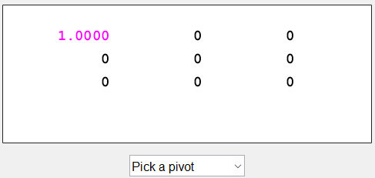
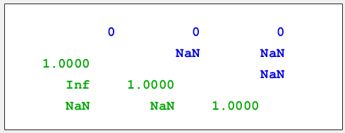
Linear Systems
Visualizer MATLAB

Slide 39
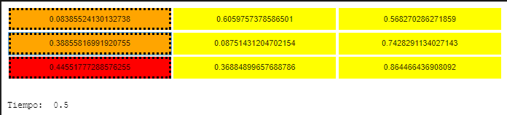
Linear Systems
Visualizer Camilo’s

Slide 40
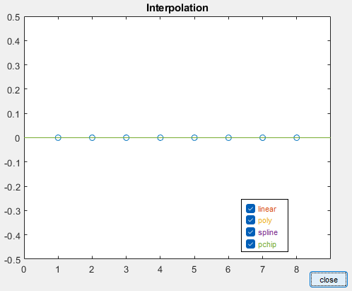
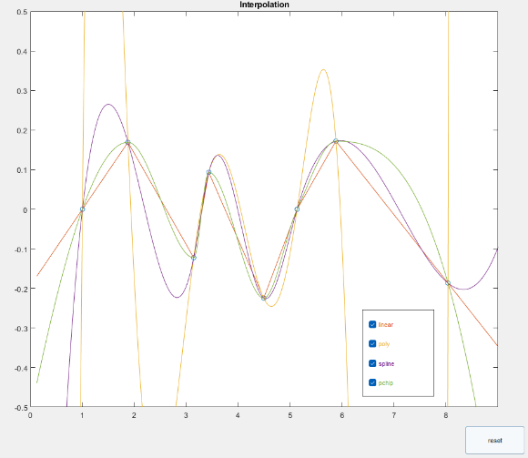
Interpolation
Visualizer MATLAB

Slide 41
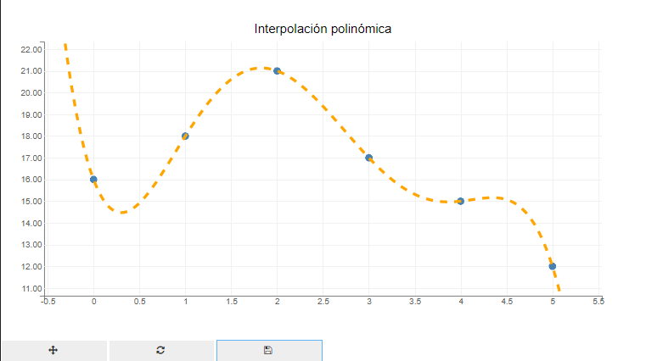
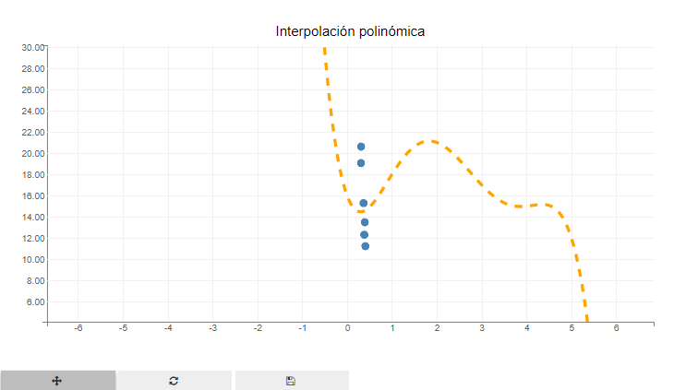
Interpolation
Visualizer Camilo’s

Slide 42
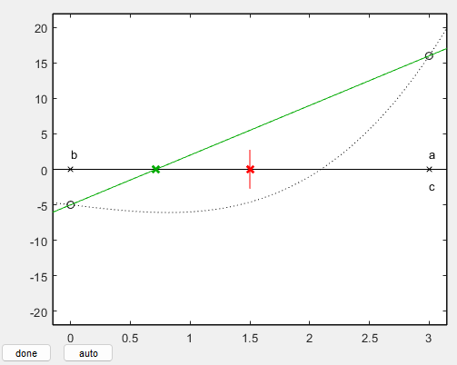
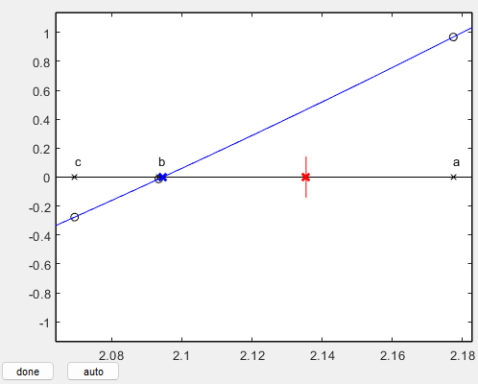
Non Linear Equation Solver
Visualizer MATLAB

Slide 43
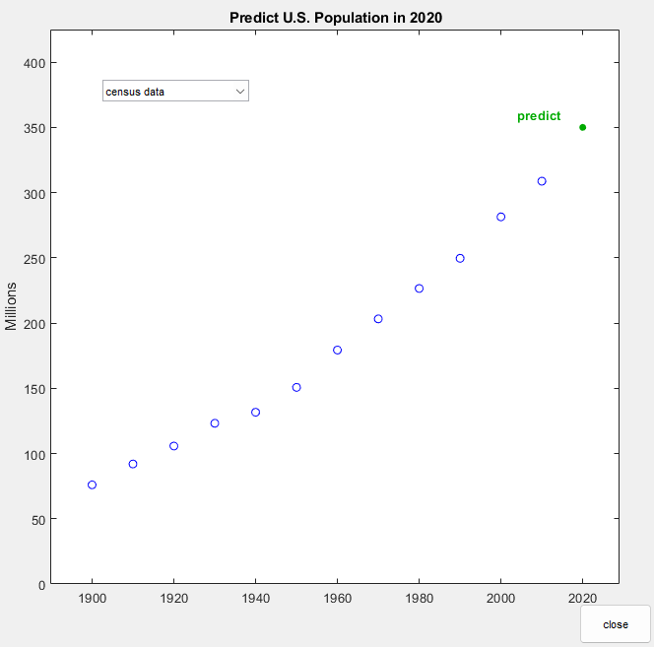
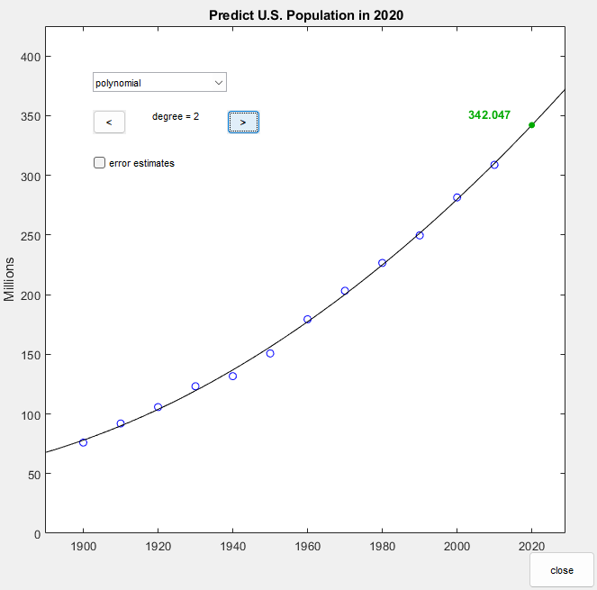
Least Squares
Visualizer MATLAB

Slide 44
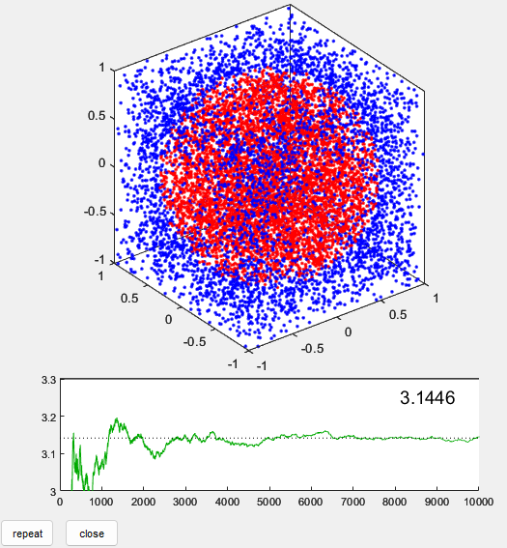
Random Number Generators
Visualizer: Montecarlo

